Slide 1

Automated Vacuum Cleaner
Presented by: Joshua O’Dell, Rudra Sharma

Slide 2
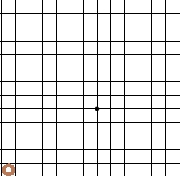
Project strategy/goal
Simulate a room in a 2D grid
Points on the grid represents the points in the room
Test a variety strategies for path finding strategies for the vacuum robot
Compare the performance of the strategies in terms of their success rate

Slide 3
Project Implementation
Ported a python codebase of basic vacuum robot into Java
Added a library [lanterna] and implemented its API to visualize the robot movements on a 2D grid
Implemented various forms of robots
Developed a test matrix to run the clean simulations and compute averages

Slide 4
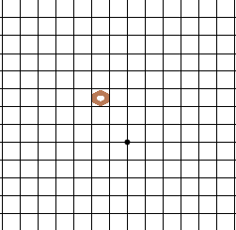
Basic Bots
Random Robot - Randomly chooses next adjacent location on the grid and moves to that point
Store Map Bot - Randomly chooses next location on the grid, however it knows about its room borders, uses simple heuristic to determine a border point

Slide 5
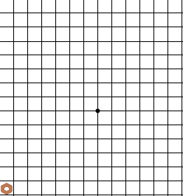
Store Map & Maintain Direction Bot
Knows the borders of the room
Heuristic to strategize the direction travels
Only travels North, South, East, West (not north-west, south-west …)
When it hits a border it slides to an adjacent box and moves in the opposite direction

Slide 6


Store Explored Robot
Holds all the points the bot has explored
Uses heuristic to give priority on its neighboring nodes
R = $\left\{\begin{aligned}not visited:\sum_{i=0}^{visited}{Distance(point,i)} \\ visited: SizeOf(visited)\end{aligned}\right.$
Minimize the distance to existing points

Slide 7
Proximity Robot
Contains a proximity sensor to detect how close it is to the edge
This program matches closely the features of the Roomba product.
Program starts by spiraling out, until it reaches a wall. Then it randomly chooses a direction and follows that direction until it hits another wall, and so on.

Slide 8
Hybrid bots
Some hybrids are better at complementing each other then other
Adding Proximity sensor to the Store Explored resulted in better results
Adding a map to the Store Explored did not help much
Some don’t perform as well integrated (store maps and explored)

Slide 9
Performance
 | Required percentage cleaned
 | 10% | 20% | 50% | 80% | 100%
Store Explored | 100% | 100% | 100% | 100% | 100%
Proximity | 40% | 34% | 27% | 25% | 25%
Store Explored & Proximity | 100% | 100% | 100% | 100% | 100%
Stored Map | 100% | 100% | 100% | 100% | 100%
Random | 96% | 77% | 40% | 12% | 0%
Store Explored & Stored map | 100% | 100% | 100% | 100% | 100%
Stored Map w/ Direction | 100% | 100% | 100% | 100% | 100%
Showing the percentage of times the robot was able to clean the room to the required percentage.
Each robot was given 1,000,000 steps to complete the task

Slide 10
Performance
 | Required percentage cleaned
 | 10% | 20% | 50% | 80% | 100%
Store Explored | 100% 535 | 100% 1487 | 100% 8491 | 100% 22586 | 100% 39161
Proximity | 40% 600159 | 34% 660395 | 27% 732261 | 25% 759790 | 25% 906491
Store Explored & Proximity | 100% 539 | 100% 1207 | 100% 3857 | 100% 7163 | 100% 16898
Stored Map | 100% 373 | 100% 890 | 100% 3895 | 100% 9006 | 100% 42284
Random | 96% 146783 | 77% 282504 | 40% 680976 | 12% 894746 | 0% 1000000
Store Explored & Stored map | 100% 499 | 100% 1413 | 100% 7541 | 100% 19681 | 100% 34037
Stored Map w/ Direction | 100% 160 | 100% 335 | 100% 947 | 100% 1756 | 100% 2408
Average steps to clean to required percentage

Slide 11
Confirmations and Surprises
When you know the room, you can calculate the most efficient path
But that is not a realistic scenario
Removing 100% cleaning allows for most algorithms to succeed
Some algorithms can be augmented by another precept
Others will fight it.

Slide 12
Future areas for improvement
Elimite low-performing strategies
Refine high-performing algorithms
Add more obstacles to our environment
Add live/in-motion obstacles to the room

